Slide 1






CoopReflect: Towards Natural Language Communication for Cooperative Autonomous Driving via Multi-Agent Learning
Jiaxun Cui¹, Chen Tang¹, Jarrett Holtz², Janice Nguyen³, Alessandro G. Allievi², Hang Qiu³, Peter Stone^{1,4}
¹The University of Texas at Austin, ²Robert Bosch LLC, ³University of California, Riverside, ⁴Sony AI

Slide 2
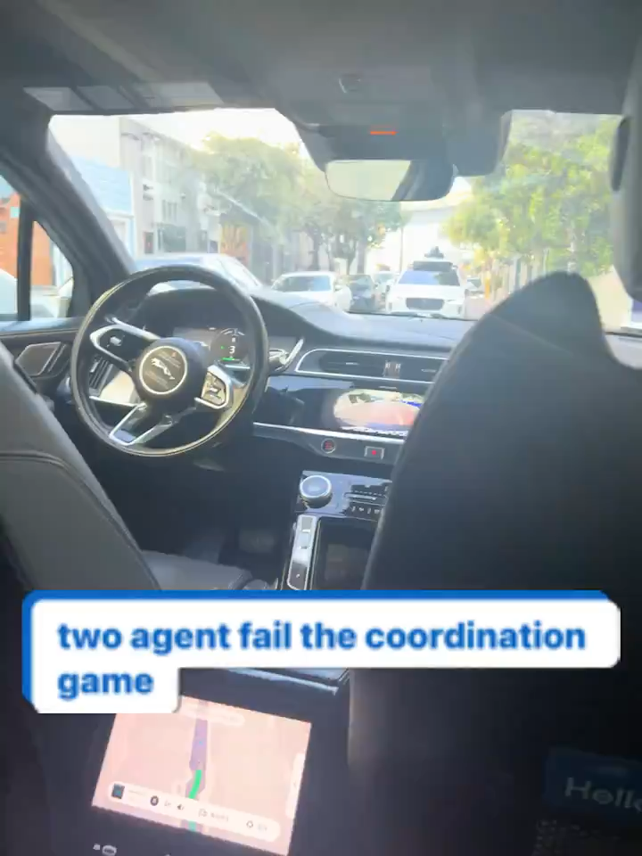
Waymo vs Waymo
Motivation Video Talking Vehicles
Notes:
Both are working in silent mode and playing the best response to human drivers

Slide 3
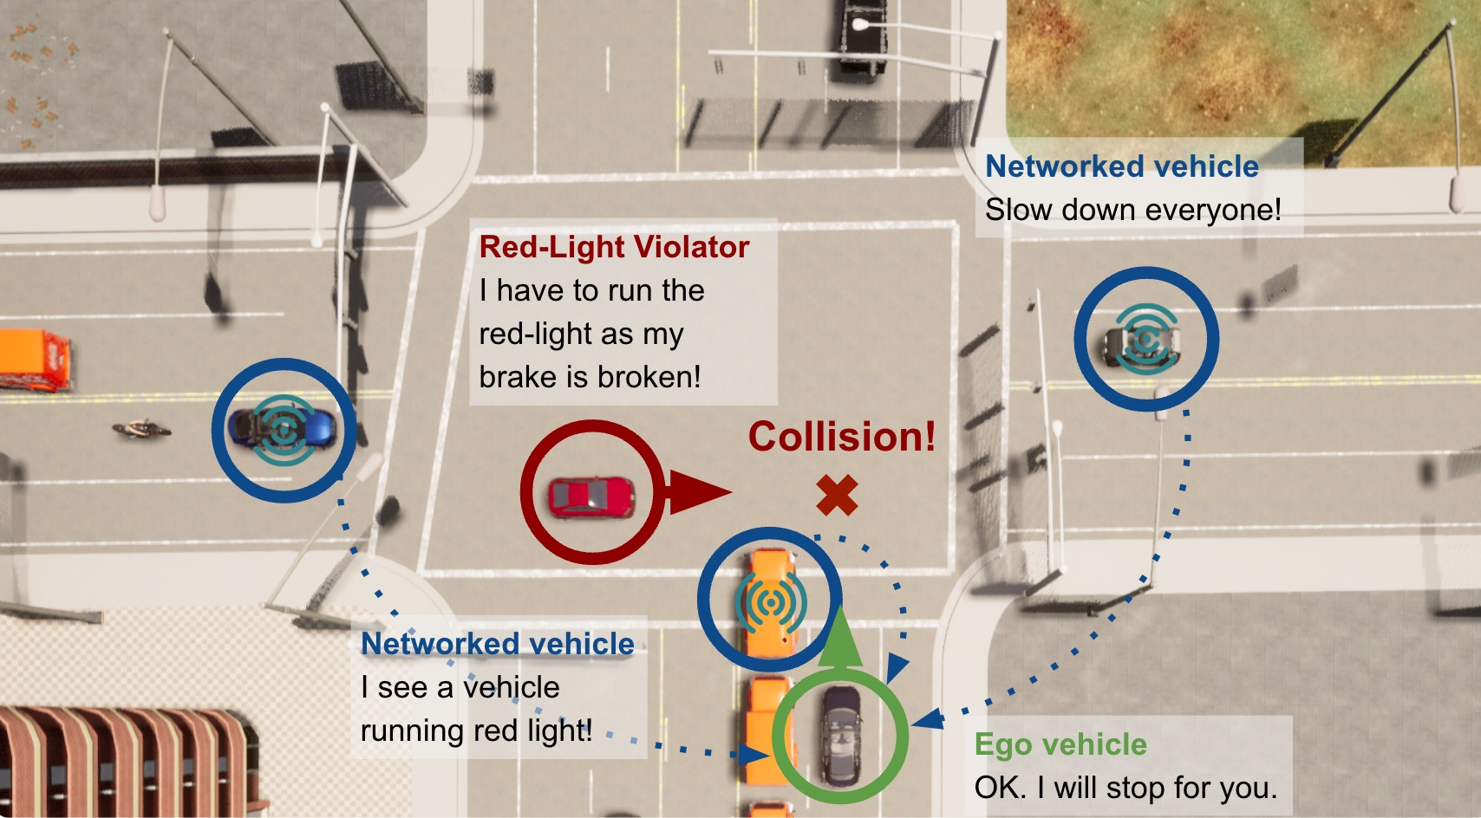

Slide 4
How to make embodied agents (cars) to speak and coordinate physically with natural language?
Different from board games, only trajectories make sense for continuous tasks + spatial reasoning
Data featuring cooperative driving in natural language does not exist! 😭
Language structural model + RL self-play finetuning [Lewis et al. 2017]
Language model behavior cloning + RL value filtering [Meta FAIR et al. 2022]
LLM diverse prompt + RL selection [Xu et al. 2023]
👉🏻 Can we learn from a few self-play interactions among LLM Agents? 🤔
[1] M. Lewis et al. Deal or no deal? end-to-end learning for negotiation dialogues. 2017.
[2] Meta FAIR. Mastering the game of no-press diplomacy via human-regularized reinforcement learning and planning. Nature, 2022.
[3] Xu et el. Exploring large language models for communication games: An empirical study on werewolf. NeurIPS 2023.

Slide 5

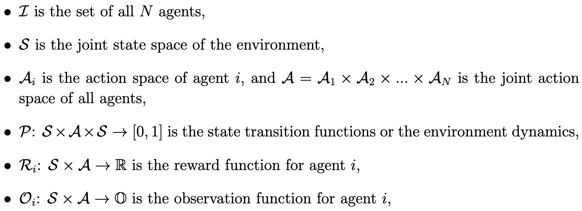
Problem Formulation I
Partially Observable Stochastic Games
Partial observability
Individual rewards that may not fully align

Slide 6
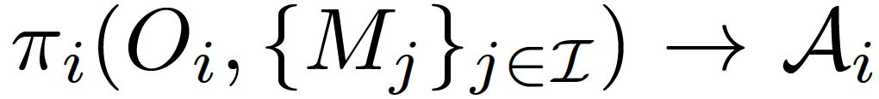
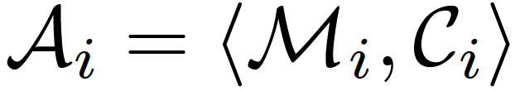
Problem Formulation II
Definition 1 (focal population) A set of controllable agents that optimize their joint rewards given any background agents.
Optimization Objectives: The social welfare of focal population agents.
Joint action space of
<messages, control>
How to generate meaningful natural language messages
How to comprehend the received natural language messages and incorporate them into high-level cooperative driving decisions?

Slide 7

In-Context Knowledge -> Autoregressive Model
Chain-of-Thought Reasoning
Agent Framework
Task
LLM Agent Policy
Observation
Chain-of-thought Reasoning
Control Command
Received Messages
Message

Slide 8
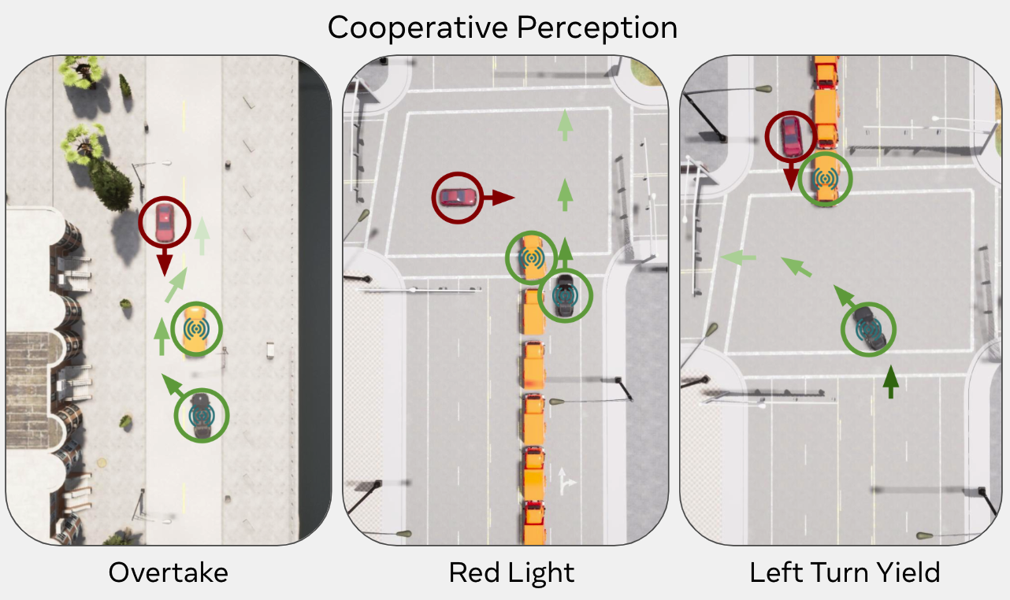
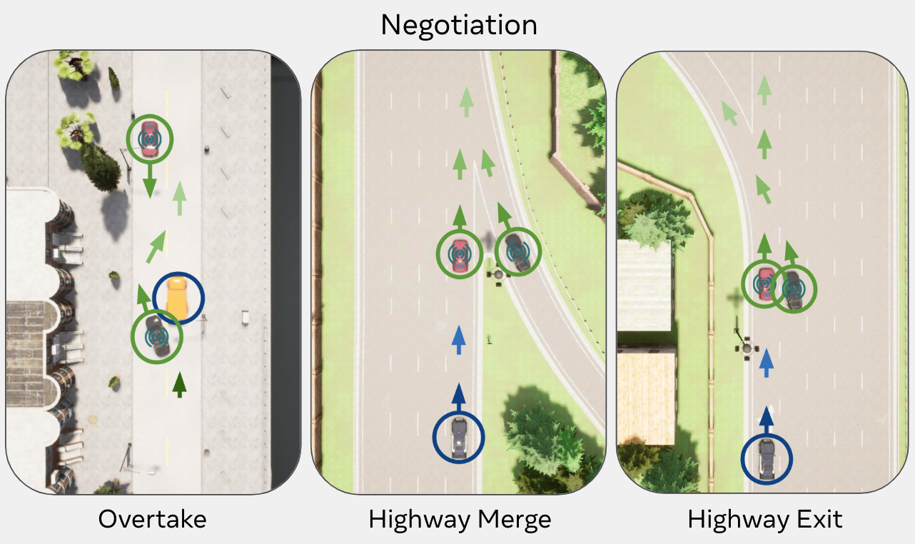
TalkingVehiclesGym Scenarios
Focal Agents
Potential Colliders
Background Agents
Language-specified Individual tasks that may not fully aligned (need to cooperate on perception or negotiation)
Text scenario description with partial observability awareness to reduce the perception difficulty
Action space: natural language message generation and atomic controls
go, slow done, speed up, stop, change to the left lane, change to the right lane

Slide 9
Can LLM agents establish collaboration without prior interactions?

Slide 10
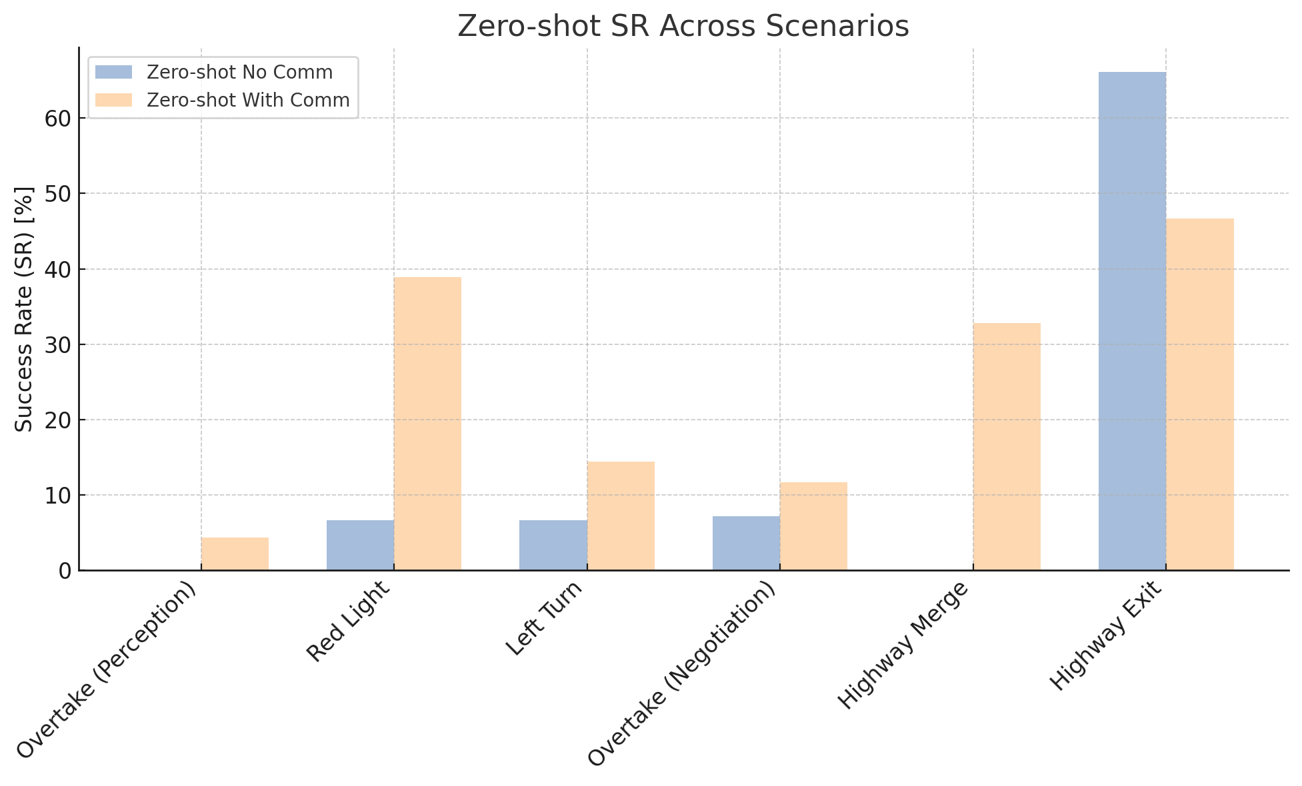
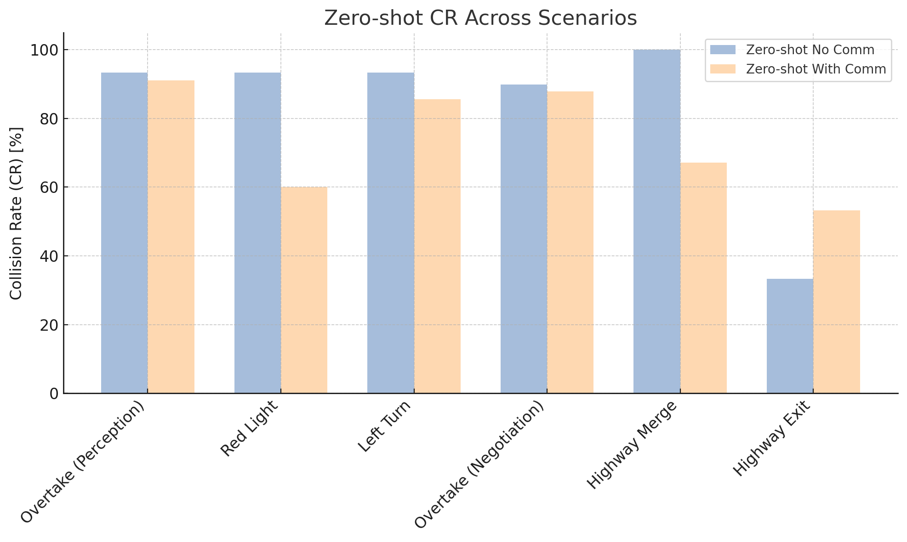
Agent Zero-shot Performance
Low Success Rates
High Collision Rates

Slide 11
agents do not communicate effectively to understand each other's needs in perception or achieve agreement in negotiation
even when the messages make sense to humans, agents do not respond with appropriate driving commands
Why do the agents fail?

Slide 12
Multi-agent learning is needed

Slide 13
Agent Framework
Task
LLM Agent Policy
Observation
Chain-of-thought Reasoning
Control Command
Received Messages
Message

Slide 14
In-Context Knowledge -> Autoregressive Model
Chain-of-Thought Reasoning
Agent Framework (learning enabled)
Task
LLM Agent Policy
Observation
Chain-of-thought Reasoning
Control Command
Received Messages
Message
Knowledge
Strategy

Slide 15
TalkingVehiclesGym Scenarios
Focal Agents
Potential Colliders
Background Agents
Diagnostic verbal feedback “vehicle 111 collides with vehicle 120” “Vehicle 109 stagnated too long for the task”

Slide 16

Replay Buffer
Rollout interaction trajectories
Retrospectively relabel each time step when the episode concludes
$$a_{t}$$
$$o_{t}$$
$$o$$
$$a$$
$$o$$
$$a$$
$$o$$
$$a$$
$$a$$
$$o$$
$$a_{t}$$
$$o_{t}$$
Message Passing

Slide 17
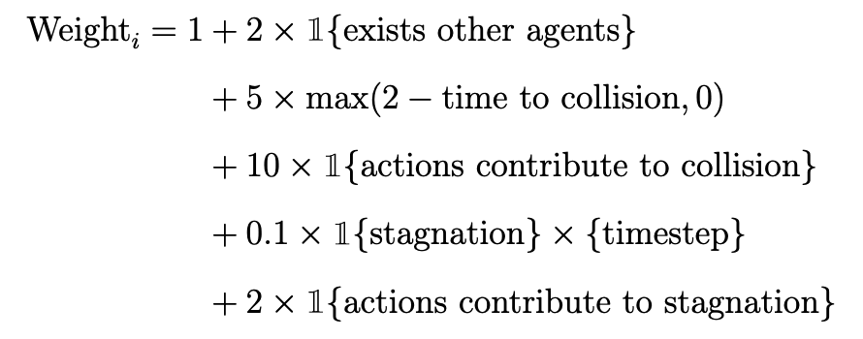
Replay Buffer
Rollout interaction trajectories
Retrospectively relabel each time step when the episode concludes
Prioritized batch sampling for trajectory analysis
$$a_{t}$$
$$o_{t}$$
$$o$$
$$a$$
$$o$$
$$a$$
$$o$$
$$a$$
$$a$$
$$o$$
$$a_{t}$$
$$o_{t}$$
Message Passing

Slide 18



CoopReflect
$$a_{t}$$
$$o_{t}$$
This is the interaction trajectory and the feedback on the task.
$$a_{t}$$
$$o_{t}$$
I think we failed the task because … I propose that A should do xxx, and I will do xxx…
Why did the collision / stagnation happen?
Here is a revised cooperation strategy, I will do xxx, and B will do xxx
Context Reflection
Debrief

Slide 19
Research Questions
Does enabling natural language communication necessarily enhance the coordination of LLM agents from those without?
Does decentralized reflection improve collaborative capability over interactions?
Does centralized discussion among LLM agents provide additional improvements in collaboration and communication compared with decentralized reflection?

Slide 20
Metrics and Baselines
60 episodes Round-Robin among randomly shuffled [risky, safe] scenarios with 50% vs 50% percentage. Early Stop with 20 Consecutive Successful Episodes
Metrics
Average Total Reward normalized by group size
Average Success Rate normalized by group size
Average Collision Rate normalized by group size
Baselines in both Silent and Comm mode
Zero-shot
Decentralized Reflection
Centralized Debrief
Correction + RAG [Wen et al., 2023]
gpt-4o-mini for “fast” acting (~8s)
gpt-4o for analysis & reflection
Wen, Licheng, et al. "Dilu: A knowledge-driven approach to autonomous driving with large language models." arXiv preprint arXiv:2309.16292 (2023).

Slide 21
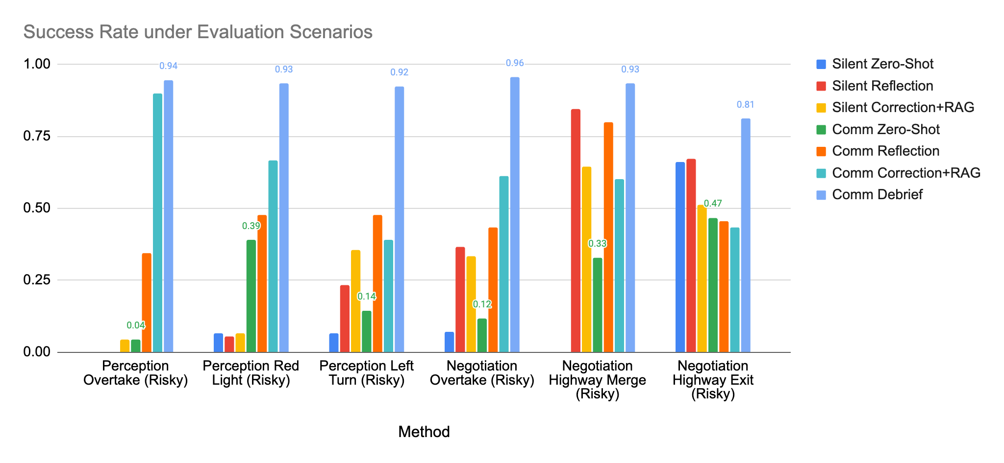
Quantitative Results

Slide 22
Findings
Communication does not guarantee collaboration in zero-shot interactions ❌ {gpt-4o-mini, llama3-8b-instruct, gpt-4o, gpt-o4-mini}
Decentralized reflection and correction with RAG memory reduce collisions. ✅
Centralized debriefing enhances coordination more than decentralized reflection. ✅
The potential of natural language communication for multi-agent ✅❌

Slide 23
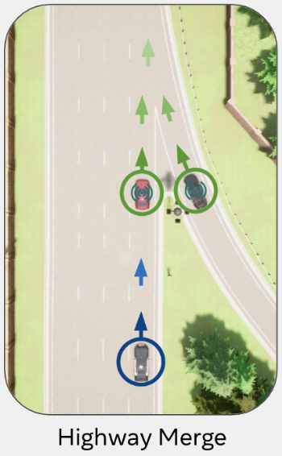
Example Generated Cooperation Strategy
Highway Merge (Negotiation) Knowledge learned by the merging vehicle
Knowledge To effectively merge onto the highway when in a hurry, I should initiate communication by clearly stating my intention to merge, including my current speed and position. As I approach the merge point, I will gradually accelerate to match the highway speed. Continuous communication is essential to coordinate actions and avoid collisions. I must maintain a safe merging distance and speed, avoiding abrupt maneuvers. I should also be prepared to adjust my speed dynamically based on real-time feedback from the highway vehicle.,
Cooperative Strategy In our cooperative strategy for merging onto the highway, the merging vehicle (myself) will initiate the process by clearly communicating its intention to merge, including its current speed and position. As the merging vehicle approaches, it will gradually accelerate to match the highway speed, ensuring a smooth transition. The vehicle in the rightmost lane of the highway will proactively create a gap by slightly reducing its speed earlier, allowing the merging vehicle to enter the lane without needing to match speeds precisely. Throughout the process, both vehicles will maintain clear communication, with the merging vehicle leading in signaling its actions and the highway vehicle responding by adjusting speed to facilitate a safe merge.

Slide 24
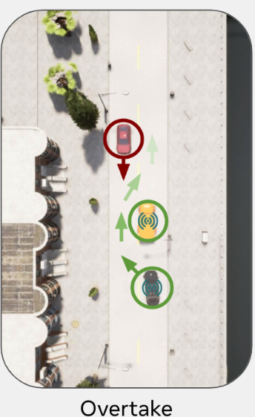
Emergence of Concise Communication Protocol
Overtake (Perception) Communication Protocol by LLM+Debrief, seed 12, checkpoint-28
In the revised cooperative strategy, the stationary truck in lane 1 will continuously monitor the traffic in lane -1 and provide real-time updates on the speed and distance of oncoming vehicles. If the gap is not safe for overtaking, the stationary truck will send a “hold” message to prevent premature maneuvers. As the overtaking vehicle, I will use my sensors to independently verify the traffic conditions in lane -1 and maintain a flexible speed, ready to adapt dynamically. I will only proceed with the overtaking maneuver when both the stationary truck's updates and my sensor data confirm a safe gap, at which point the stationary truck will send a “go” message. This dual verification approach ensures alignment in our actions, minimizing the risk of collision and avoiding stagnation by allowing me to adjust my speed based on real-time conditions. If no safe gap is available, I will maintain my position and communicate my readiness to adapt speed as necessary, ensuring a coordinated and safe overtaking process.

Slide 25
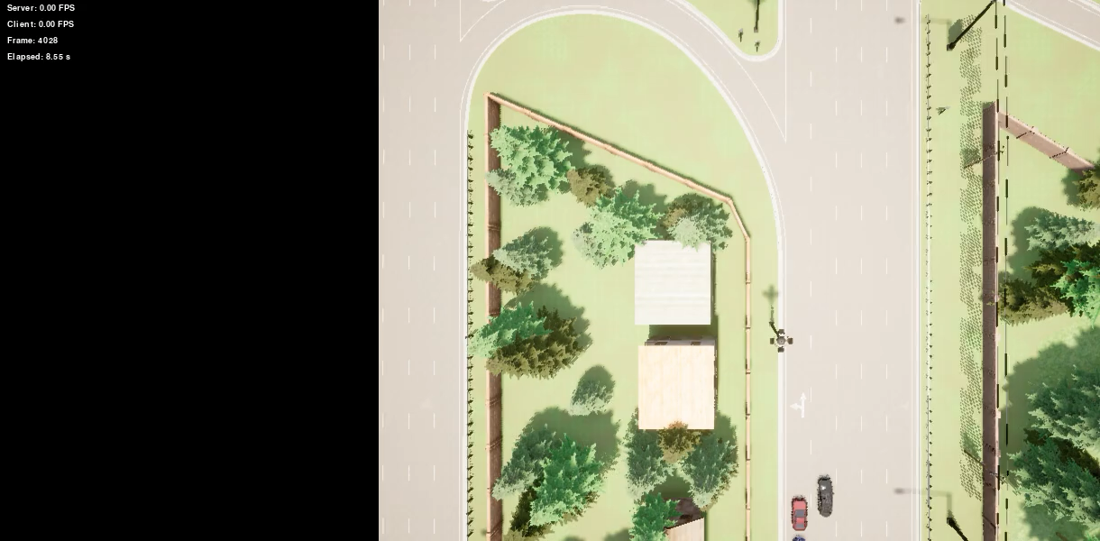
Qualitative videos

Slide 26
Scenario Generalization A single policy that works for all roles and scenarios
Store knowledge from all vehicles
Store successful interaction trajectories
<observation , action >
Behavior cloning with a small language model
Retrieve relevant knowledge
$$max log p(action|obs)$$
Centralized Memory
Distillation

Slide 27
Inference Time & Message Size Reduction
10 Seconds
Decision
Latency
<0.5 Seconds
Compared with large model
5.1 Mbps
Bandwidth Requirement
<0.01 Mbps
Compared with Coopernaut

Slide 28
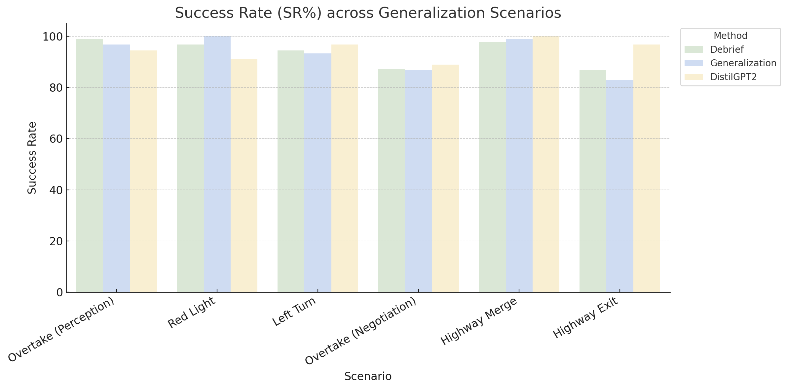
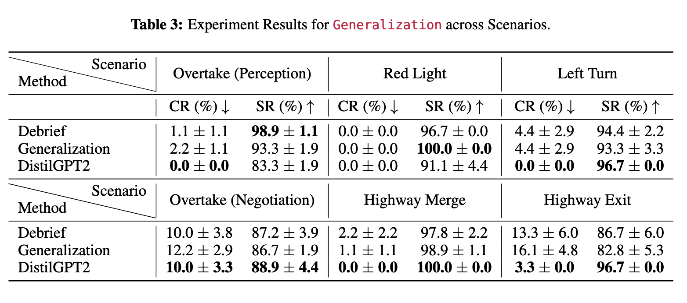
Distilled model trained by filtered BC maintains performance

Slide 29


Slide 30
Among the first V2V natural language communication systems in simulation with policy optimization
Novel multi-embodied-LLM agent self-play learning method

Slide 31
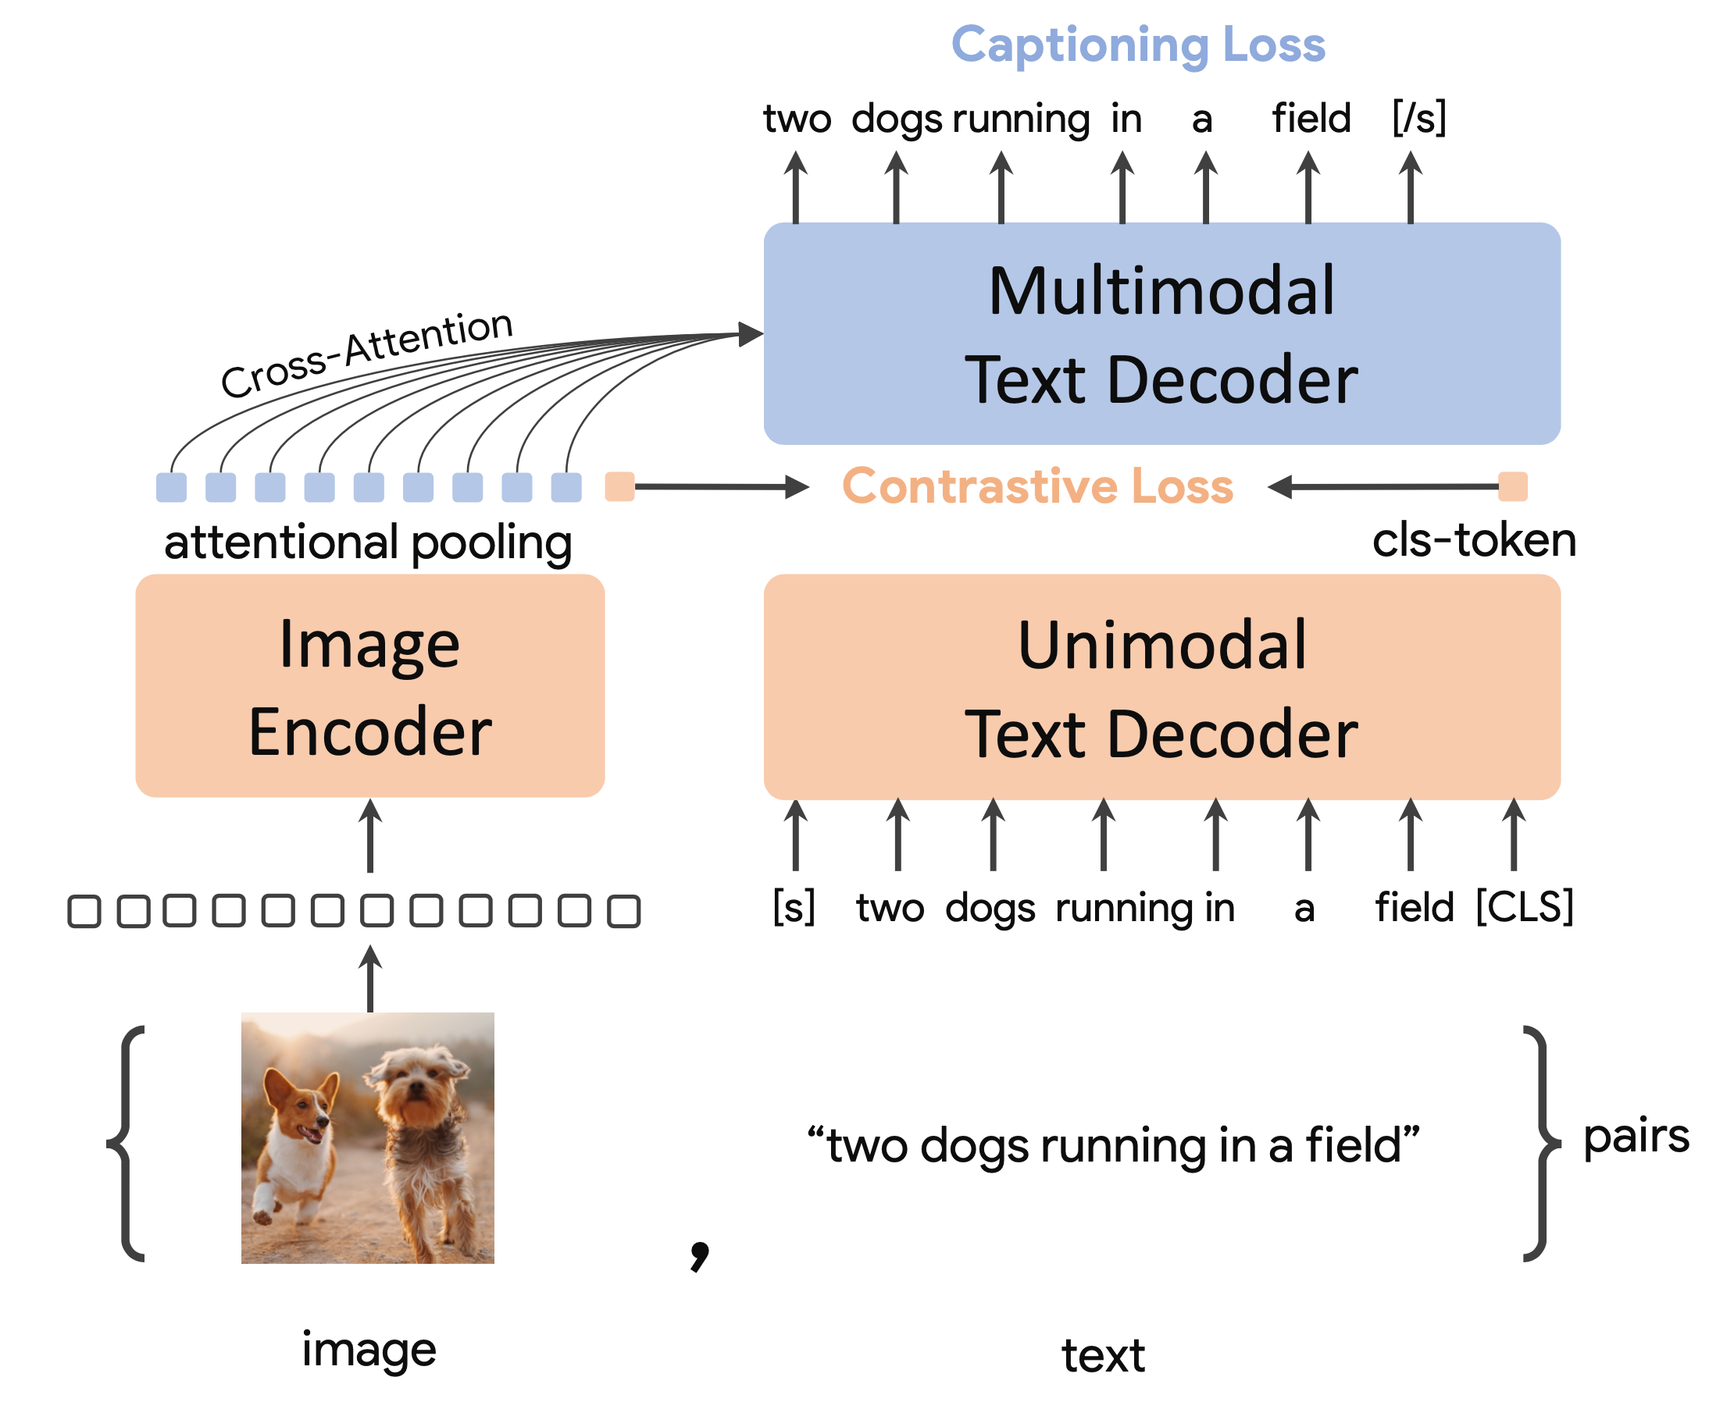
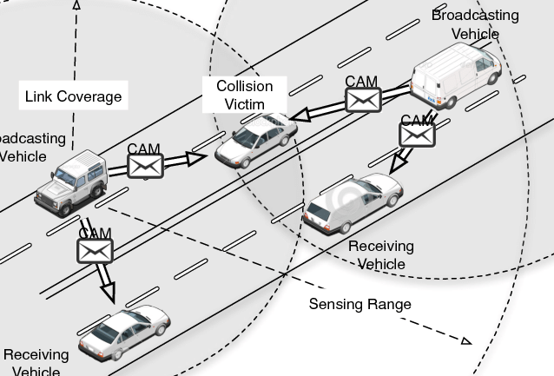
Discussion
1. VLM / MLLM to use sensor perceptions / physical understanding / planning
2. Imperfect communication considering time delays package losses, and corruption
3. Adversarial attack on collaboration
4. Ad hoc teamwork

Slide 32
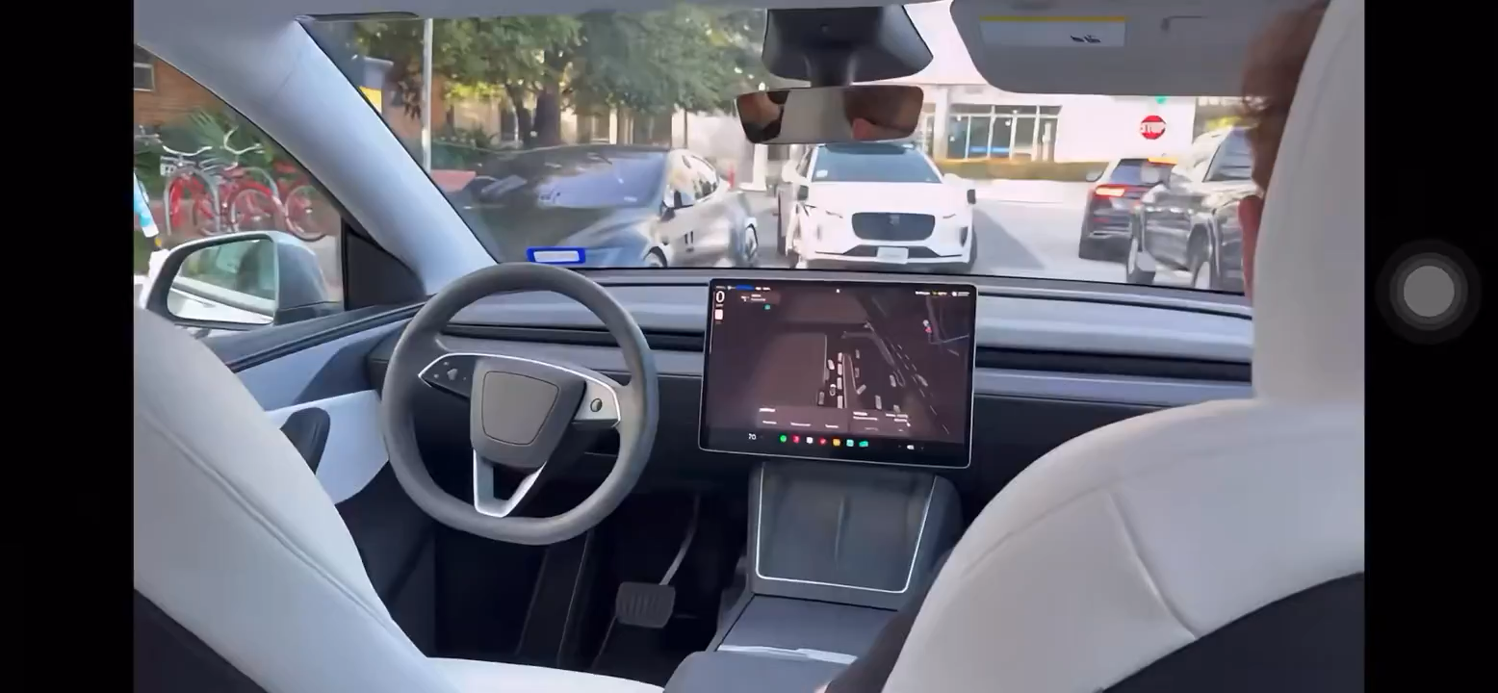
Tesla vs Waymo
Tesla vs Waymo video

Slide 33


Open-sourced!
I yap on twitter

